Slide 1
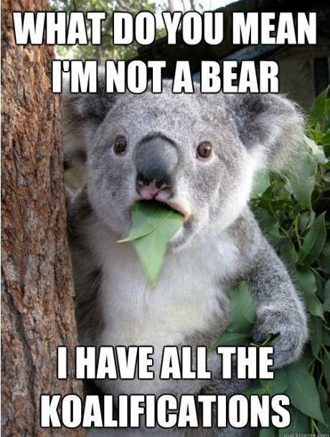
Source

Slide 2
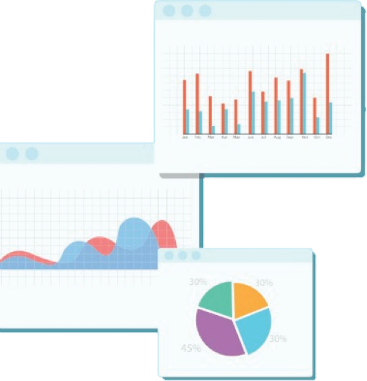


Welcome to Week 7
Lecture 2!
Data Science in Python &
Machine Learning

Slide 3
Announcements:
Belt Exams This Friday:
Weeks 5-6 assignments and resubmits due by Friday 3/11 by 9AM PST
Must have attended 80% of the live lectures
Must have submitted 90% of assignments
Set aside at least a day between 3/11 and 3/13 to complete exam.
I have posted the solution notebook to the mock belt exam today on the discord channel.
Try the mock belt exam as a classification problem.
Purvi will be joining the data science instructor team
Josh Johnson joining in on the lectures

Slide 4
Learning Goals
By the end of this lesson you will be able to:
Define a hyperparameter
Regularize a model by tuning hyperparameters
Determine what hyperparameters a model has for tuning
Explain cross-validation
Efficiently determine the optimal hyperparameter settings for a model using GridSearchCV

Slide 5
Hyperparameters
Parameter: A value learned by a model. For example:
Coefficients for Linear and Logistic Regression
Rules for Splitting Nodes in a Decision Tree
Hyperparameter: A developer tuned value or argument in a model. For example:
K in K-Nearest Neighbors
Max Depth in a Decision Tree
C in Logistic Regression

Slide 6
Tuning Hyperparameters
Regularization
Increase/decrease model complexity
Experiment with different model approaches
Solvers in logistic regression
Distance metrics in KNN

Slide 7
GridSearchCV:
Tune many hyperparameters at once
Try all combinations
RandomForestClassifier:
n_estimators = [50, 100, 200]
max_depth = [4,7,10,20]
min_samples_split = [2, 10,100] (or can give a range; range(1,10))
max_features = [‘auto’, ‘sqrt’, ‘log2’]
Gridsearch will try all combinations and return the best!

Slide 8
Model Development Cycle with GridSearch CV
Prepare the best version of your data that you can. This affects model performance.
Model Type should be explored next
Tuning hyperparameters should be explored last.

Slide 9
GridSearchCV
As you become more comfortable with machine learning, you will want to optimize the models you use by “tuning the hyperparameters.”
Learning and understanding all of the hyperparameters associated with each model is beyond the scope of this course, but you can still try different combinations to see what produces the best results.
GridSearchCV allows us to test multiple combinations of hyperparameters at a time to more easily determine the optimal values.
The more combinations you try, the longer it will take to run the GridSearchCV!
Note: If you want to try many combinations and get faster output, you can also try RandomizedSearchCV which will only test a sampling of your hyperparameters. It will go faster to help you narrow down your values for GridSearchCV.

Slide 10
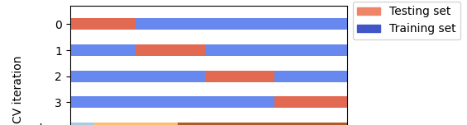
What does the CV in GridSearch CV mean?
Cross-Validation!
Image Source and Learn More Here!

Slide 11
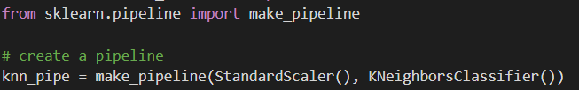
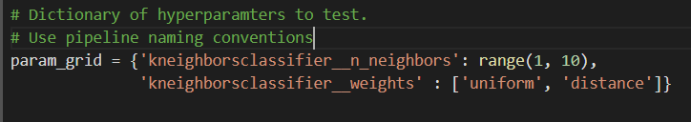
Steps to follow
Make the pipeline
Param Grid Dictionary:
Define the hyperparameters you want to try. Note that since you are using make_pipeline, the lowercase name of the model followed by __ (dunder) will precede the name of the hyperparameter.

Slide 12


How did I know the prefix in the param grid?
Examine the pipe object to see the names of the steps
The KNN step is named ‘kneighborsclassifier
In the param grid, access the step to tune with:
<name of step>__<name of parameter> (2 underscores, called ‘dunder’)
So tuning the number of neighbors to query in a KNN model would be:
Cool note, you can tune hyperparameters of preprocessing steps, too!

Slide 13
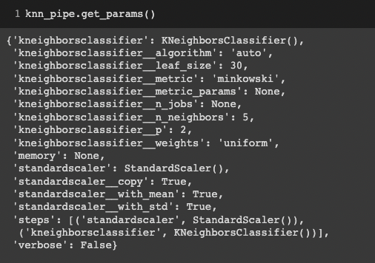
How to view the hyperparameters for a model

Slide 14
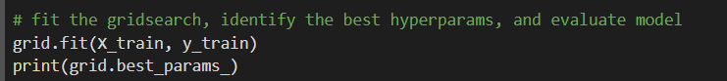

Steps to follow
1. Instantiate your grid search. Be sure to use your pipeline for the model
2. Fit the gridsearch model, identify the best hyperparameters
3. Get the best version of the model and evaluate as usual!

Slide 15
CodeAlong Notebook
CodeAlong Data
Challenge Notebook
Challenge Data

